Slide 1


Slide 2
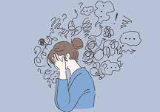


Starter task:
. What caused you the greatest stress this weekend?
. What caused you the greatest joy this weekend?
. If your weekend was a colour what would it be?

Slide 3

Course content
Morality and justice
Purposes of punishment
reformation
retribution
protection
deterrence
Responses to crime
custodial sentences
non-custodial sentences
capital punishment
Religious and non religious views on these issues

Slide 4

Learning Intentions: Today we are continuing working on the ‘fors’ and ‘against’ opinions of CP and learning about the human rights aspect of CP
Success Criteria: By the end of the lesson you will be able to:
. Reflect in more detail on the different responses to CP.
. Understand the UN declaration of Human rights and have considered the impact this has on CP.

Slide 5

Engage your brain task:
On a Post it note
1. Define capital punishment.
2. What year did the UK abolish this punishment?
3. Name three methods of CP still used today.
4. Name three countries which still have this form of punishment.

Slide 6
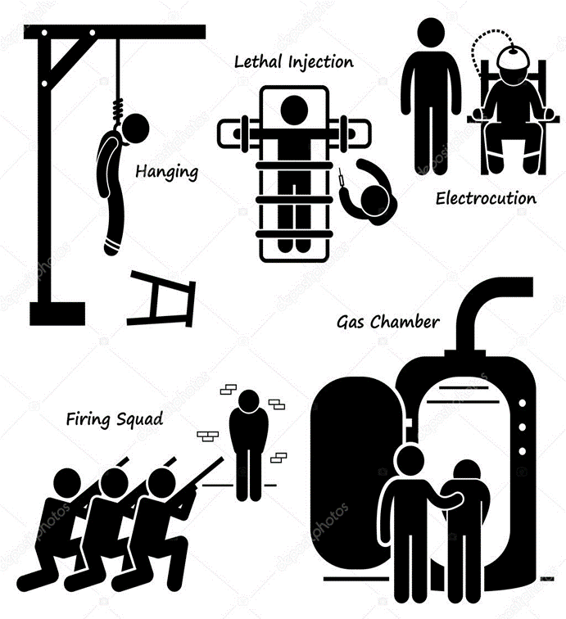
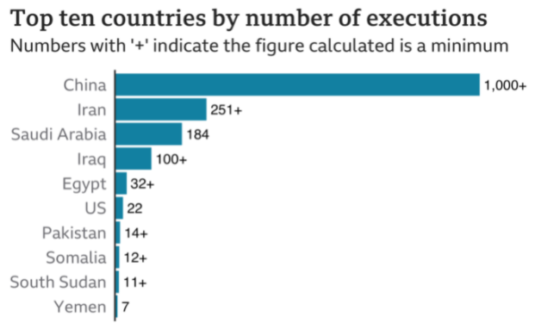
1. Definition: Capital punishment, also known as the death penalty, is the execution of a person by the state as punishment for a crime. Crimes that can result in a death penalty are known as capital crimes or capital offences.
2. Abolished in 1965.
3.
4.

Slide 7
Capital Punishment as a Moral Issue
The issue of miscarriages of justice mean that it is a moral issue.
This issue also raises questions about justice and human rights.
Some believe that human life is so sacred/special that it should never be taken (Sanctity of Life) even when someone has committed a serious crime. (Sanctity of Life)

Slide 8
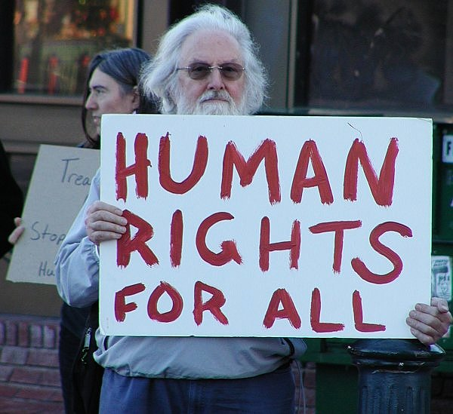

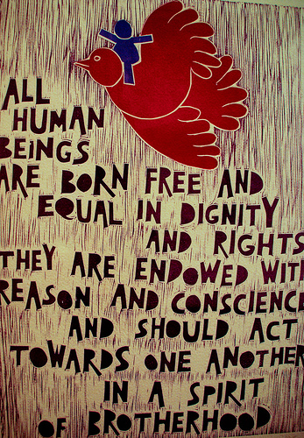
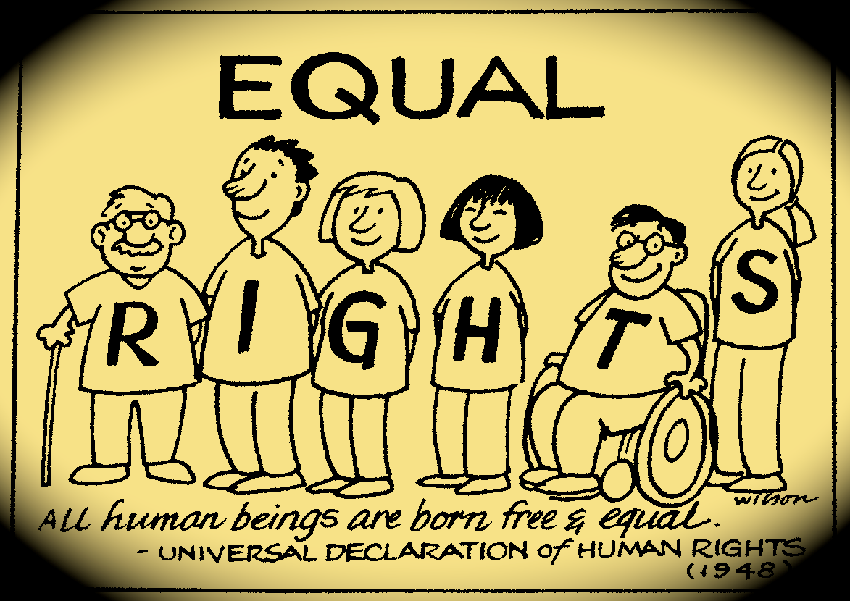
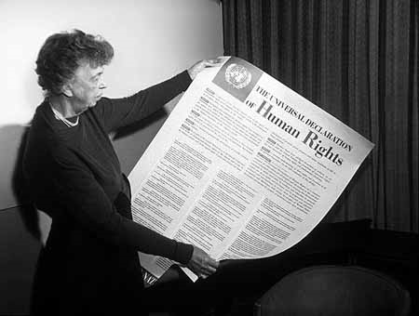
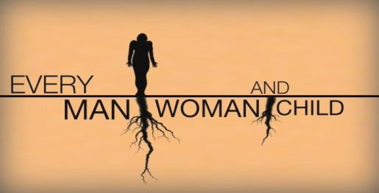

Notes:
8

Slide 9

The UN Declaration of Human Rights
After WW 2 many countries decided things needed to change.
50 delegates, each representing their country meet and eventually (2 yrs later!) the UN committee came up with a list. This list is called the UN Declaration of Human Rights and has a list of 30 things that all human beings, no matter what their race, culture, gender, age, religion or political beliefs should be entitled to.
https://www.amnesty.org.uk/universal-declaration-human-rights-UDHR

Slide 10

Lets learn a little more about Death row in the USA to help with our analysis
https://www.youtube.com/watch?v=GP6iHU1_LTQ

Slide 11


So, does Capital Punishment go against Human Rights? Lets examine 3 articles in more detail
Article 1: “All human beings are born free and equal in dignity and rights.”
C.P takes away human dignity, and the criminals rights.
In what ways are prisoners waiting for death losing their dignity?
What about their rights?
Is this ok? They are criminals after all, perhaps they deserve their rights to be removed.

Slide 12


Article 3 “Everyone has the right to life, liberty and freedom from fear of violence.”
CP takes life
If everyone has the right to life then what should happen to someone if they have taken another persons life?
Is killing someone ok if they have already killed?
Does anyone have the right to take a life?
Is life precious?

Slide 13

Article 5 “No one shall be subjected to torture or to cruel, inhumane or degrading treatment or punishment.”
The process of C.P is inhumane and lengthy and execution is degrading.
https://deathpenaltyinfo.org/executions/botched-executions

Slide 14

Is it right that CP is inhumane and degrading?
After all they are being put to death because they caused suffering so surely they should suffer?
Is there ever a humane method of execution?

Slide 15
So, does Capital Punishment go against Human Rights?
C.P takes away human dignity (Article 1)
C.P takes life (Article 3)
The process of C.P is inhumane and lengthy and execution is degrading (Article 5).
Consequently, the United Nations, the general assembly, has proclaimed that every country should abolish the death penalty.

Slide 16
Capital Punishment: recent event
. Research one recent use of capital punishment
. The name of the person who was executed.
. The name of the country where this happened.
. The date of the execution.
. The method used.
. The crime the person committed to receive this punishment
. Your opinion on this event. Do you think it is fair?

Slide 17



Here are some stories that you could use. Be warned, each one is pretty shocking.
Or find your own case to research.
USA Lisa Montgomery
https://www.bbc.co.uk/news/world-us-canada-55587260
Iran
https://www.amnesty.org.uk/iran-child-bride-executed-after-stillbirth
Egypt
https://www.amnesty.org.uk/press-releases/egypt-horrifying-execution-spree-least-57-killed-past-two-months

